Slide 1
Leaf Matching
Daniel Glownia

Slide 2
Problem Statement
Comparing leaves to find out the type of plant is challenging for botanists and consumers. Often it takes a knowledgeable botanist to extract meaningful information from a leaf, and a patient, motivated consumer with the right resources to verify the identity of a plant.

Slide 3
Related Work
Color Segmentation (Dale)
Use of color as a characteristic
Morphological processes (Jose)
Erosion
Dilation
Noise Removal (Jose)
Use of median filter

Slide 4
My Approach
Histogram Based Segmentation using OTSU gray level thresholding
Morphological processes (erosion + dilation) to get rid of noise and extract the image
Finding the Major X-Axis and Y-Axis for comparison

Slide 5
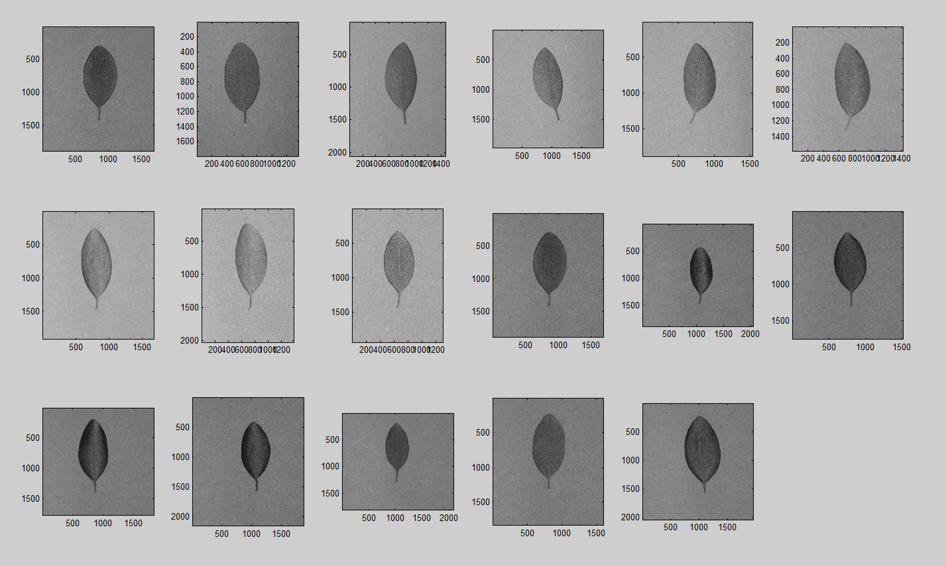
Results

Slide 6
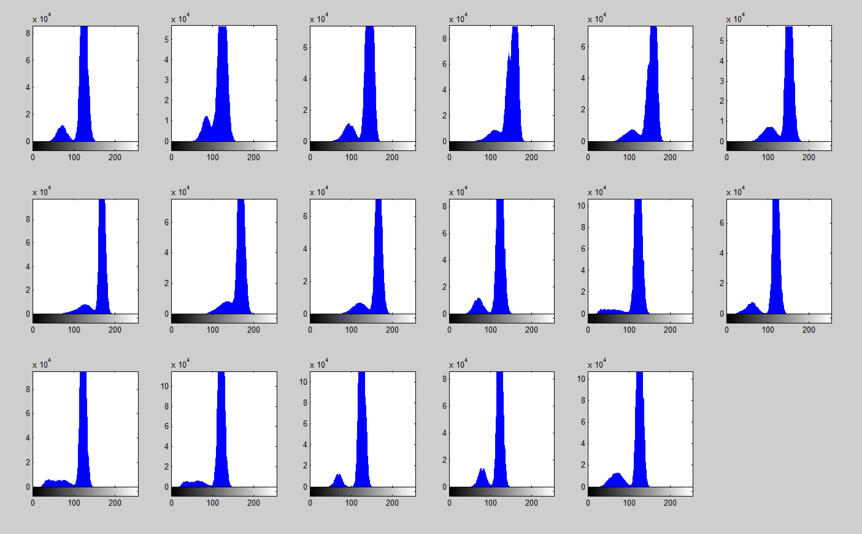

Slide 7
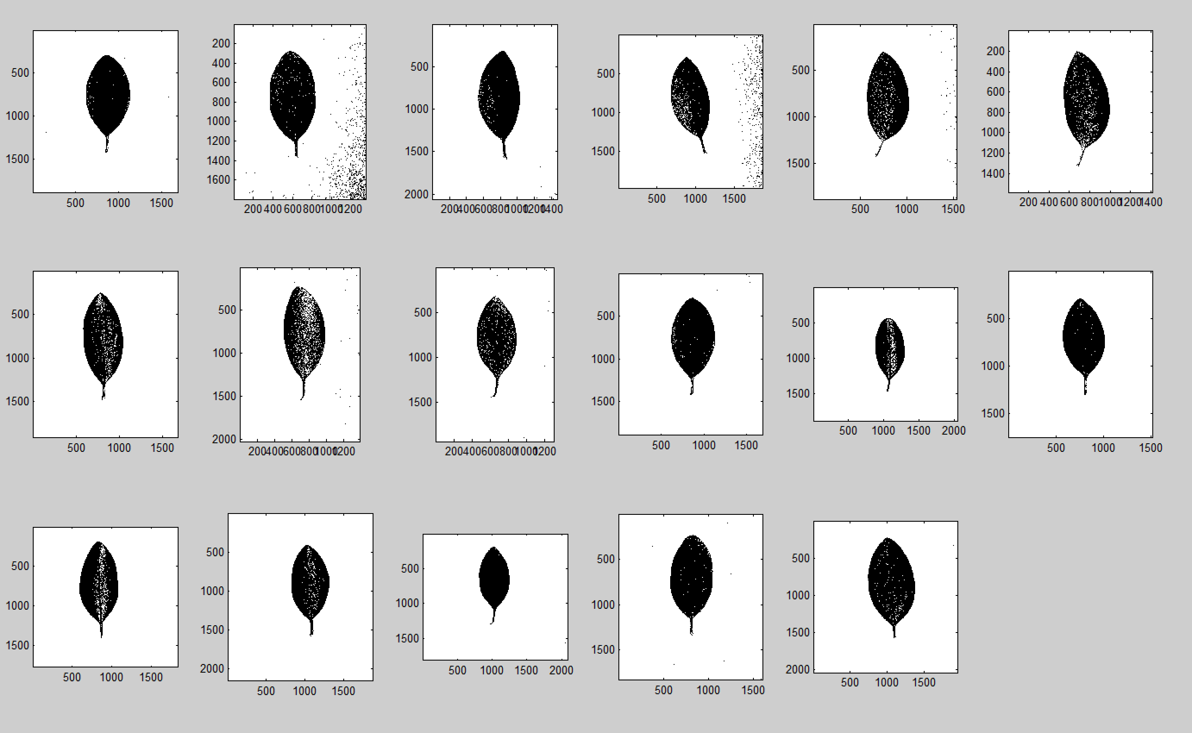

Slide 8
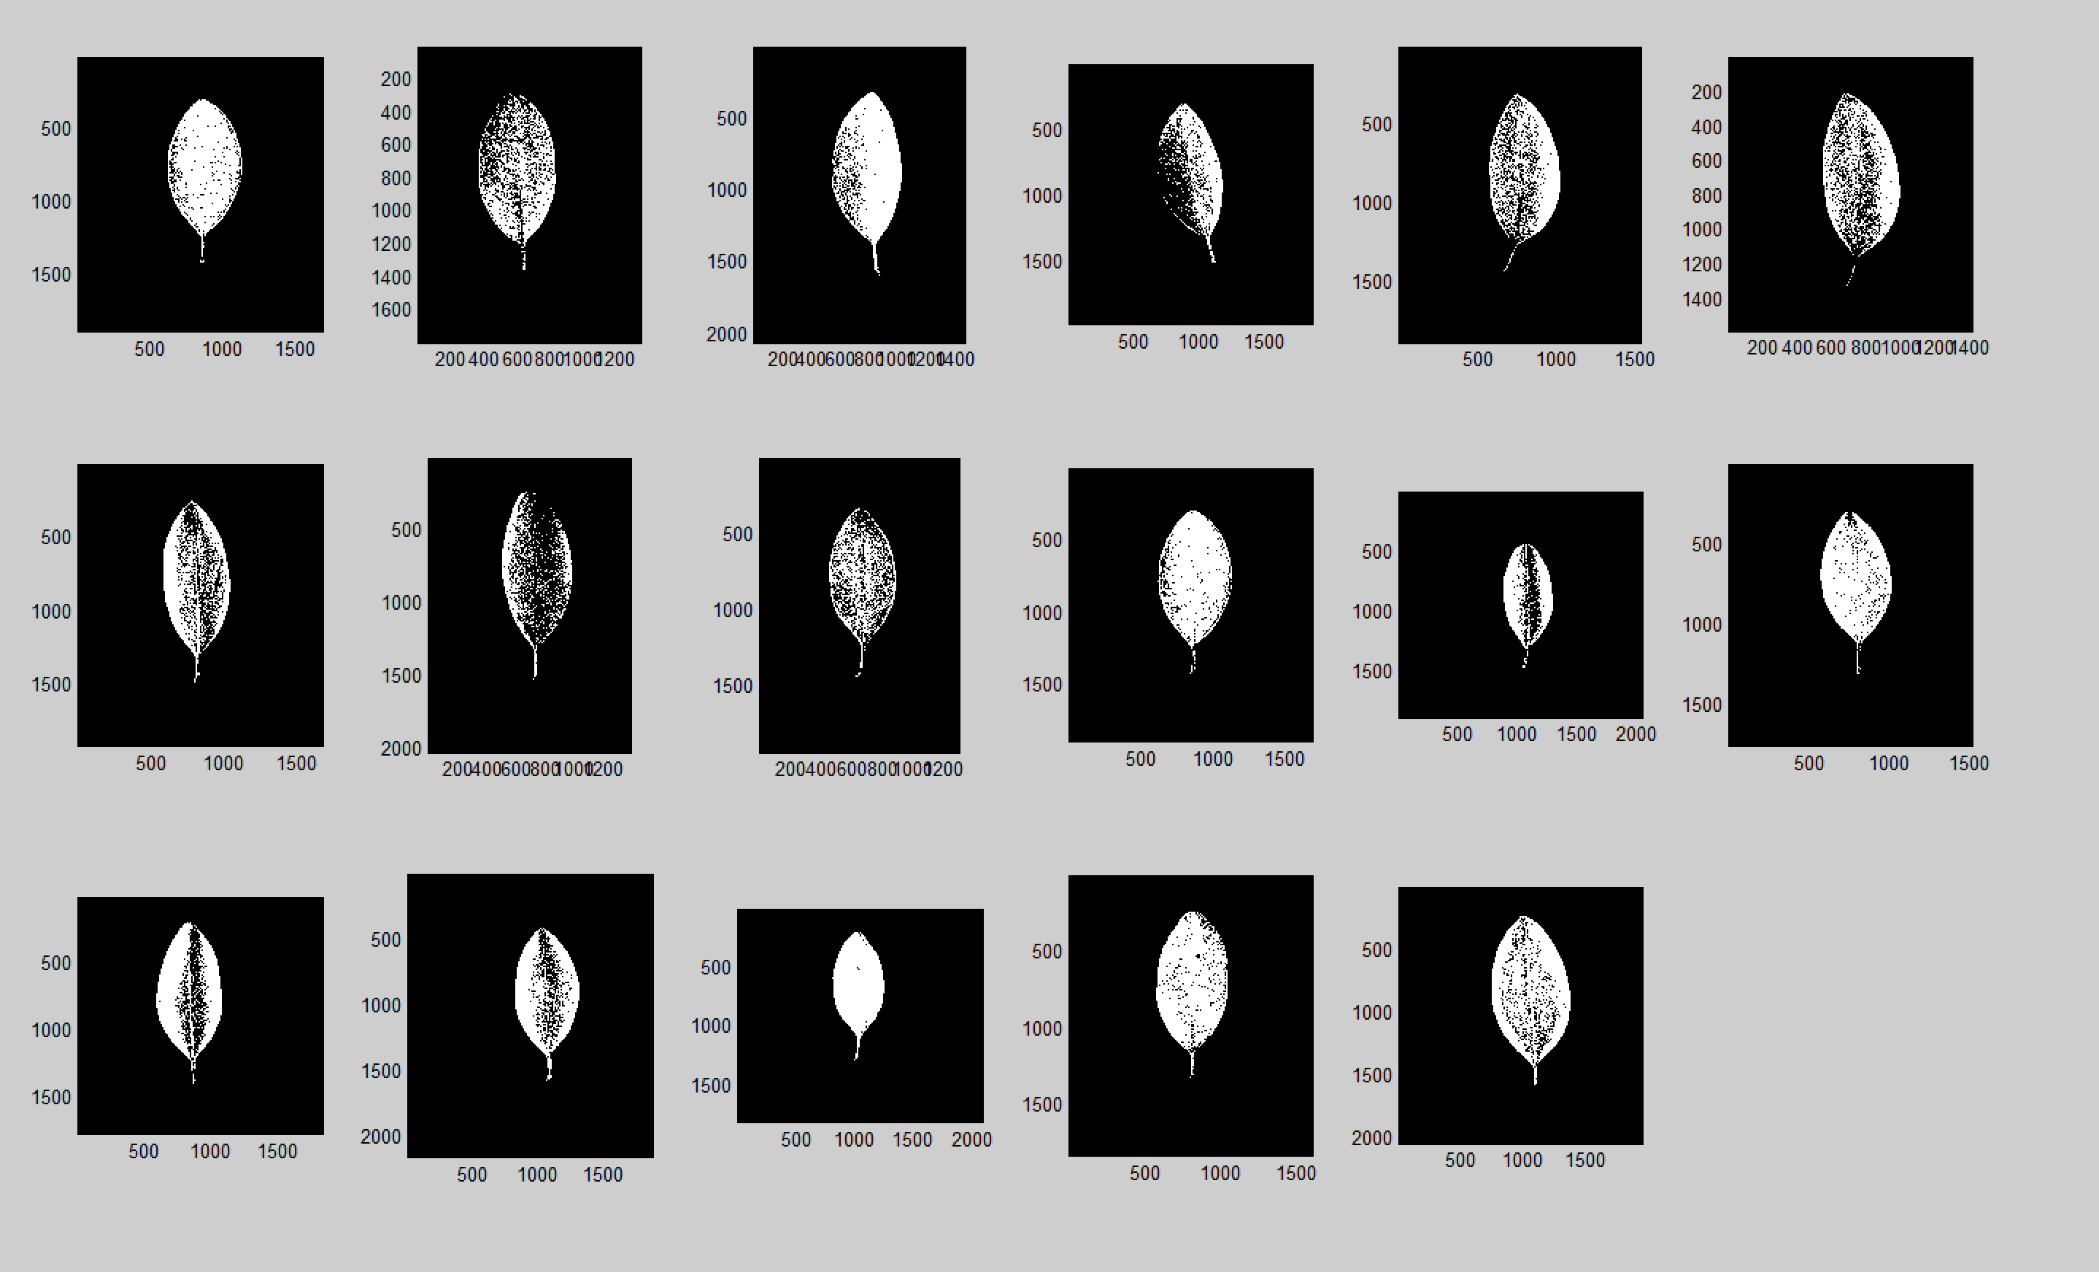

Slide 9
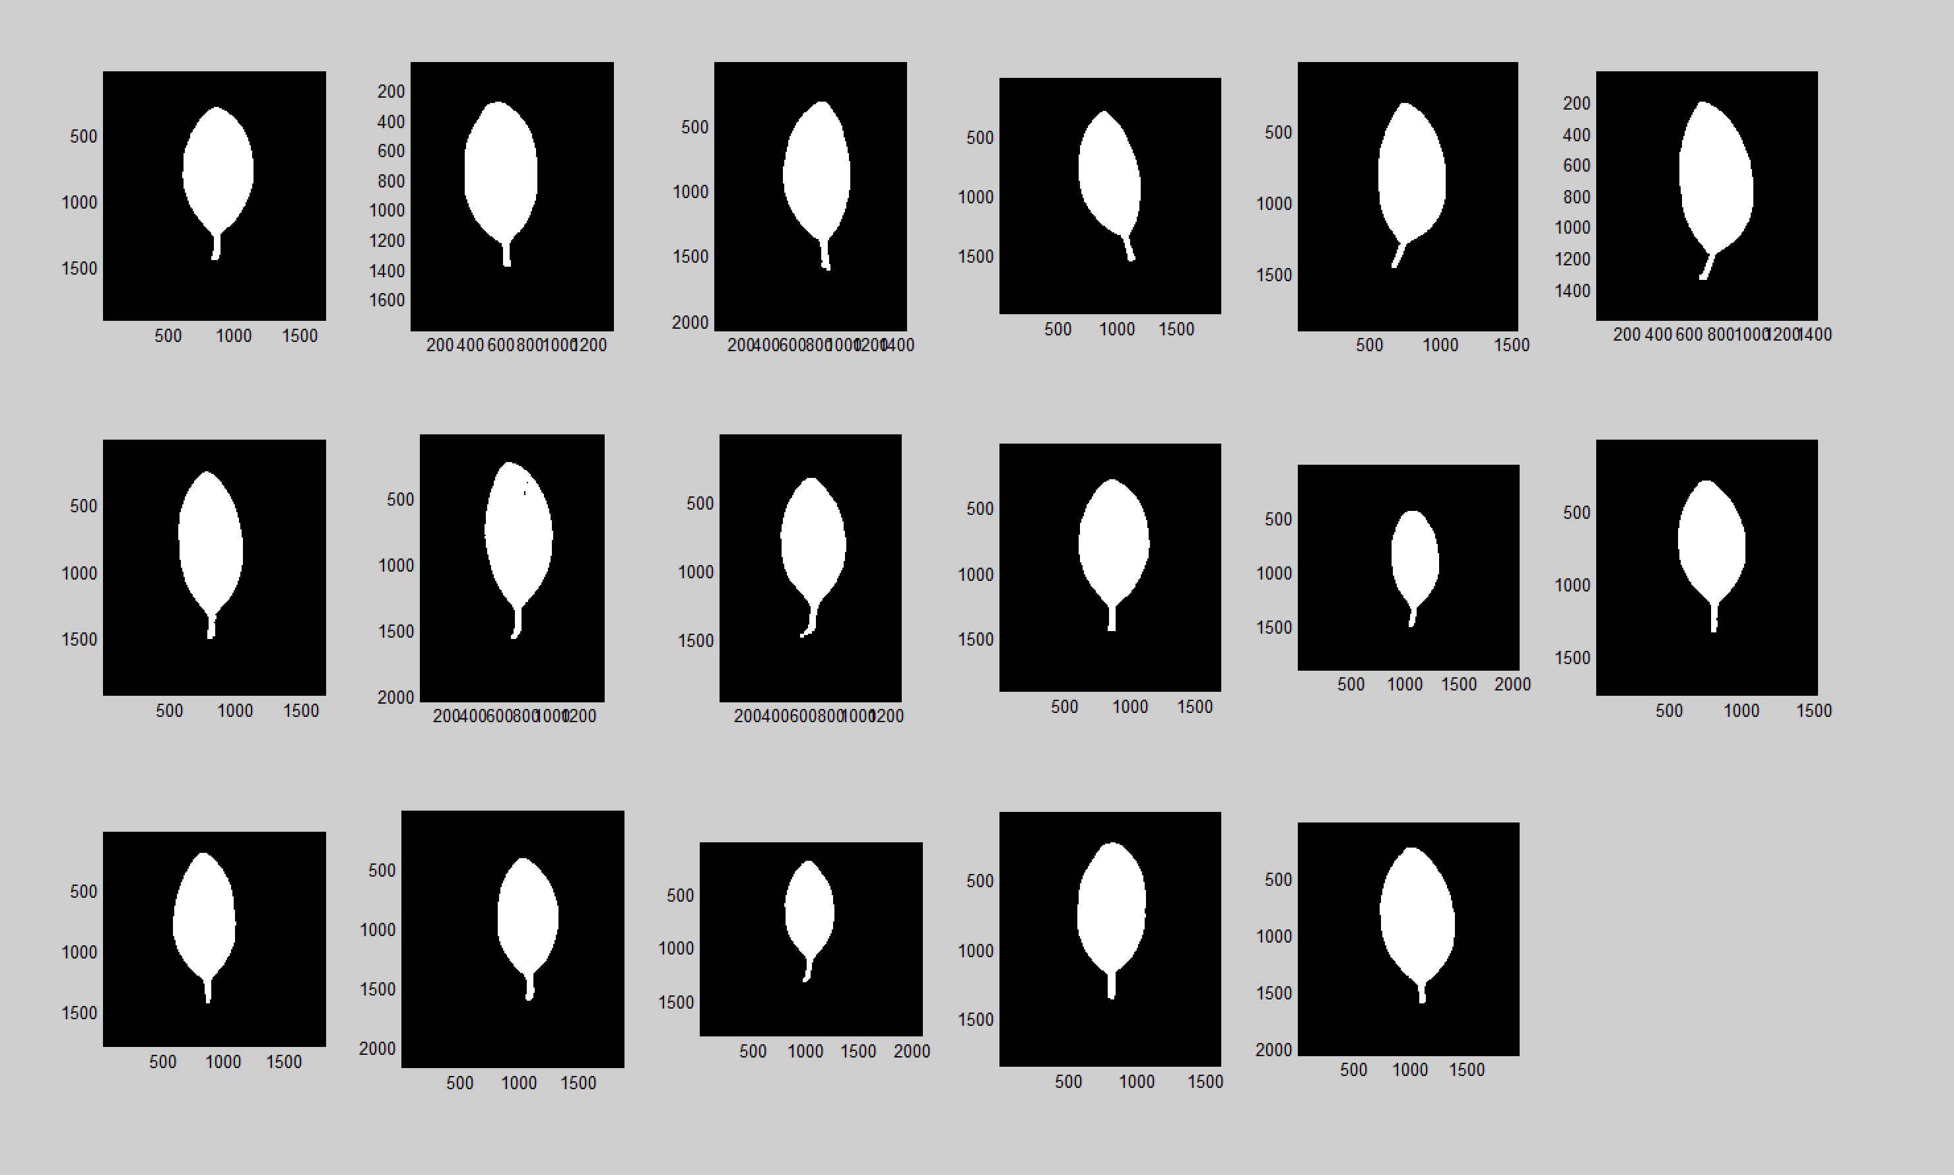

Slide 10
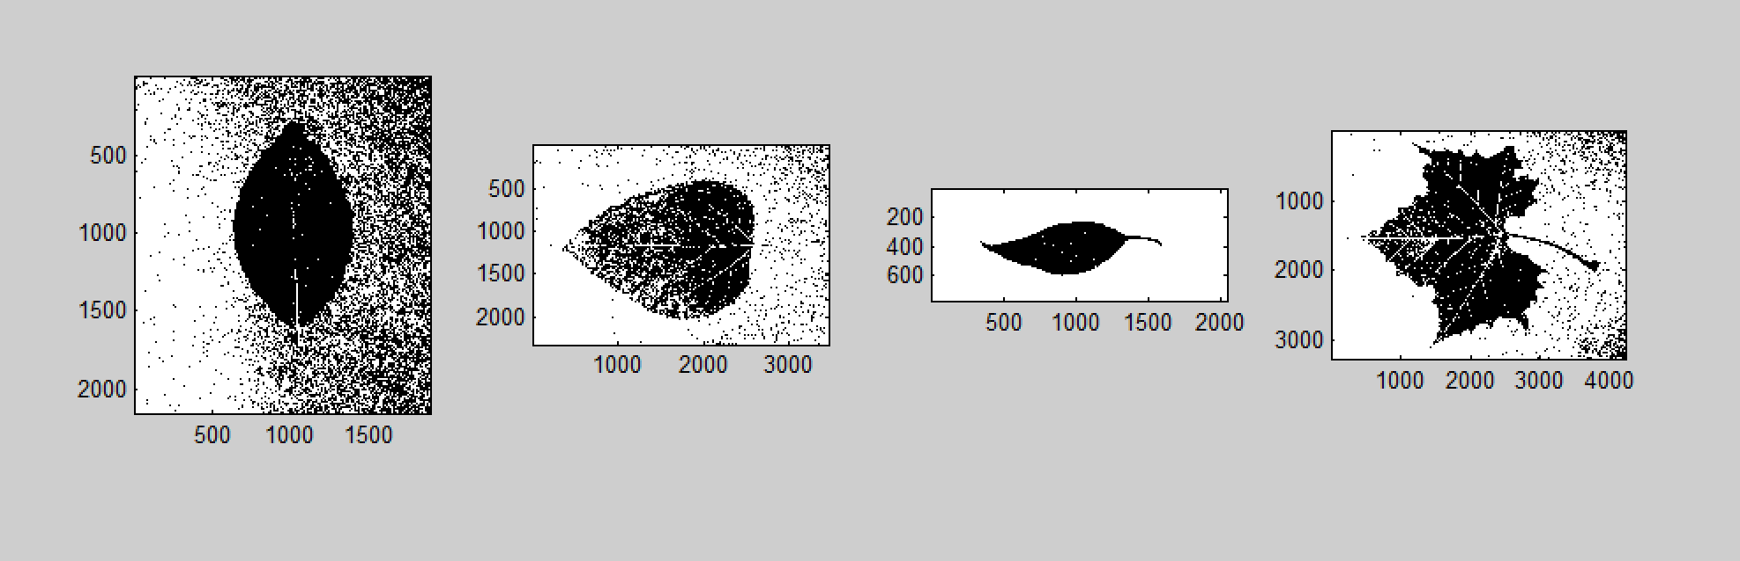
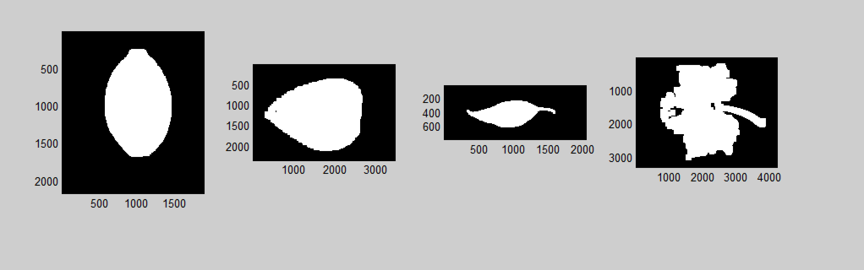

Slide 11
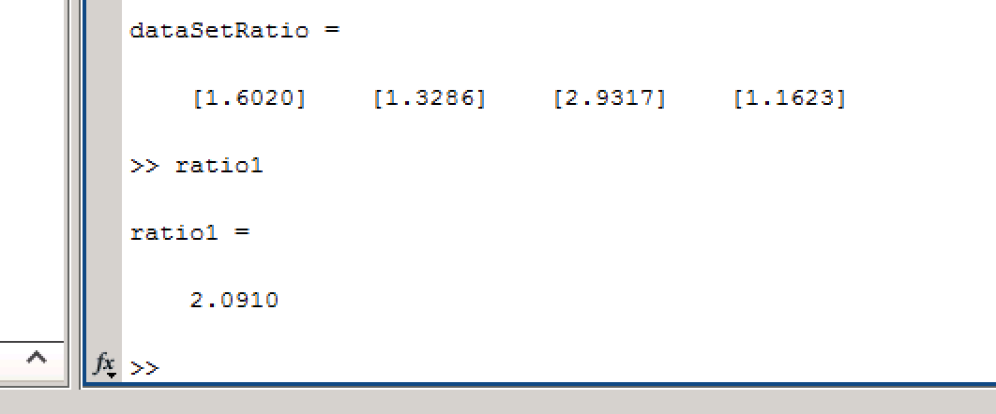
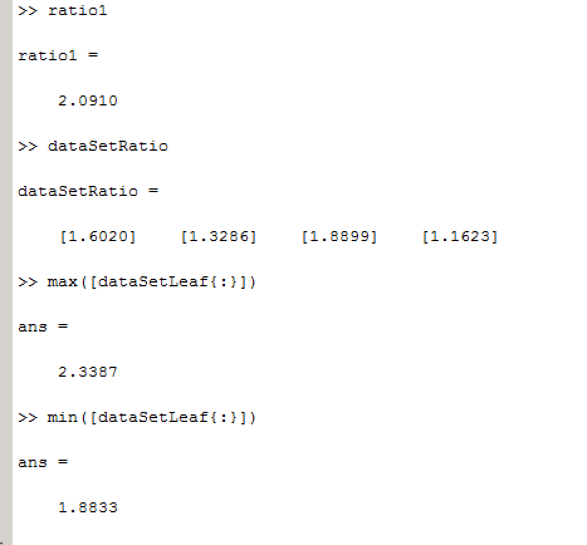

Match vs. No Match

Slide 12
Summary
Process
Histogram Segmentation (OTSU)
Morphological Operations
Axis Comparison

Slide 13
Conclusion
Areas of Strength
Histogram segmentation
Axis Analysis
Areas of Improvement
Noise reduction
Outlier retrieval with larger sets of data

Slide 14
Referances
Application of Image Processing Techniques in the Characterization of Plant Leafs Jose BOAVENTURA CUNHA
http://libres.uncg.edu/ir/asu/f/Henries,%20Dale_2011_Thesis.pdf
Hybrid Image Segmentation Algorithm for Leaf Recognition and Characterization N.Valliammal, Dr.S.N.Geethalakshmi

